Slide 1
Stock Market Prediction
Nishanth N Ballal

Slide 2
Problem
Predict the closing stock value of Nifty Index for upcoming days for the given data.

Slide 3
About Stock Market Prediction
Prediction methodologies for Stock Market Prediction fall into 3 broad categories:
Fundamental Analysis
Technical Analysis
Artificial Neural Network
For predicting the Stock Market Value based on trends of the past price, technical analysis is used.

Slide 4
Method Used
Predicting the stock market closing value based on the historical data comes under Time Series Analysis.
From the time series analysis, ARMA (Autoregressive Moving Average) model using R Programming was used to get predictions for the stock market closing value.

Slide 5
Step I: Collecting Data
The data was already available and had data of Open, High, Low, Close (stock values) and Turnover for the years March 1998 to May 2013

Slide 6
Step II: Steps followed to Forecast future stock value using ARMA model
The data of Closing Stock Value for the last one year was loaded in R Studio environment.
Code: train <- read.csv(“Asset model1.csv”)

Slide 7
Step II: Steps followed to Forecast future stock value using ARMA model
The table was viewed on R Studio Script window and a summary of the data was obtained using the commands:
View(train)
summary(train)

Slide 8
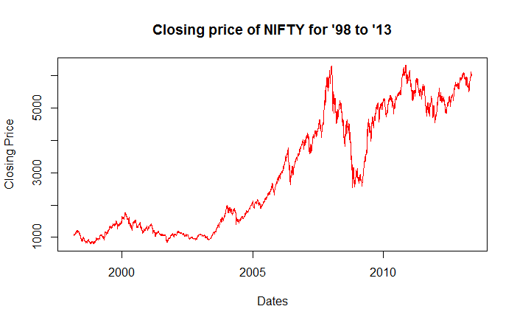
Plotting the Graph
The plot for Closing Stock Value for the given data was obtained.
Code:
plot(as.Date(train$Date, "%d-%b-%y"), train$Close, xlab = "Dates", ylab = "Closing Price", type = "l", col = "red", main = "Closing price of NIFTY for past 1 year")

Slide 9
Checking Stationarity
There seems to be a lot of randomness in the series. The series does not look stationary from the graph.

Slide 10
ADF Test
The Augmented Dickey Fuller Test was used to confirm the stationarity of the time series.
To use adf test we must include the tseries package. Once the package is loaded we can carry on with the Dickey Fuller Test.
Code:
library(tseries, quietly = T)
adf.test(train$Close)
The p value was found to be 0.2269, hence the series is not stationary.

Slide 11
Using the logged difference
From the p value, it was clear that the series was not stationary.
The method used to stationarize the series was using the logged difference values.
Code:
nifty_ret <- 100 * diff(log(train$Close))

Slide 12
ADF Test for new series
The adf test was run again on nifty_ret, to check for stationarity.
Code:
adf.test(nifty_ret)
The p value showed 0.01, hence the series is now stationary and is usable for time series analysis.

Slide 13
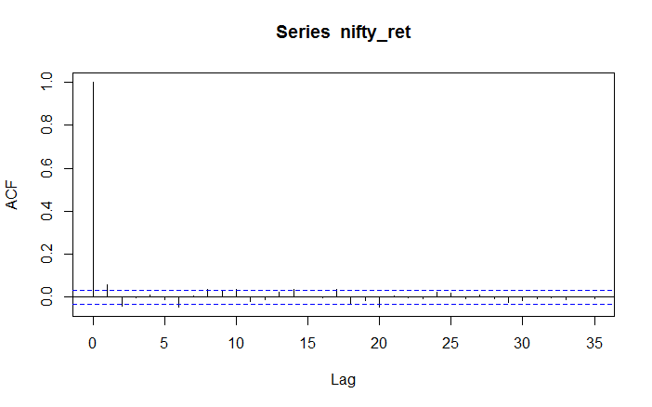
ACF plot
The Auto Correlation Factor plot can be obtained using:
Code:
acf(nifty_ret)

Slide 14
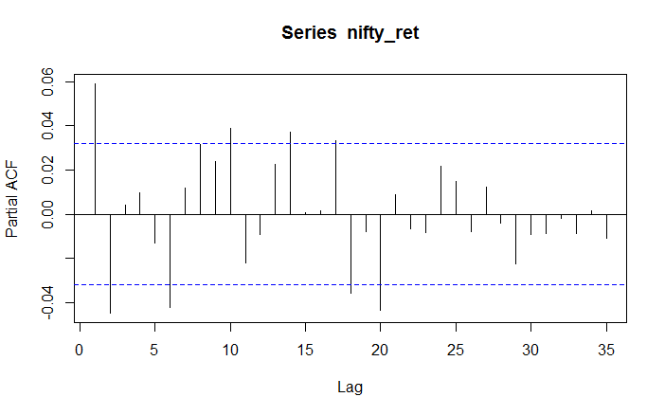
PACF plot
The Partial Auto Correlation Plot can be found using:
Code:
pacf(nifty_ret)

Slide 15
Determining order of AR and MA model
From the ACF plot we can say that the coefficient of AR is 1. Coefficient of MA is 1 or 2. We see that the AIC value is least for ARMA(1,1) model. Hence we choose ARMA(1,1) model.
Code:
summary(arma(nifty_ret, order = c(1, 1)))

Slide 16
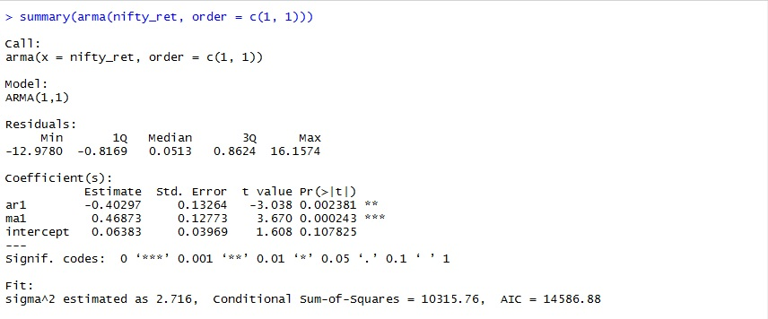
Determining Significance from Summary
From the summary we saw that our ar and ma coefficients are all significant at 99%, evident from the very small p values.
Since we need to predict the future stock value, we need to first evaluate the performance of the ARMA model in terms of out-of-sample forecast performance.

Slide 17
Dividing the Data Set into Train and Test
To find out-of-sample forecast performance, we need to divide our dataset into 2 parts.
One part will be used to train the model, other part will be used to test out-of-sample forecast ability.
Code:
nifty_ret_train <- nifty_ret[1:(0.996 * length(nifty_ret))] # Train dataset
nifty_ret_test <- nifty_ret[(0.996 * length(nifty_ret) + 1):length(nifty_ret)] # Test dataset
*Train data set has been taken 0.996 of whole data set due to the large number of data. The ARMA forecast works for a smaller number data in test dataset.

Slide 18
ARIMA Function
We have used ARIMA function to fit the model as the object type “arima” is easily compatible with forecast() and predict() function.
Our series is of I(1) order, but since the series has been differenced already, so in ARIMA function we keep the I part = 0.
Code:
fit <- arima(nifty_ret_train, order = c(1,0,1))

Slide 19
Using predict() and forecast() functions:
For the further steps we need to include forecast package from library. Then using the predict() and forecast() functions, we conduct out-of-sample forecasts.
Code:
library(forecast, quietly = T)
arma.preds <- predict(fit, n.ahead = (length(nifty_ret) - (0.996 * length(nifty_ret))))$pred
arma.forecast <- forecast(fit, h = 15)

Slide 20
Checking RMSE value
Find the accuracy of the out-of-sample prediction.
Code:
accuracy(arma.preds, nifty_ret_test) # RMSE values
The RMSE value was found to be 0.8428701

Slide 21
Forecast for Upcoming Dates
From the RMSE value we can say that the ARMA model is fit to forecast the future stock value.
We find the Stock Value for the next 3 market dates. We fit the model again with the data ‘nifty_ret’ as we have successfully tested the data. Using this fit, we find the forecast for next 3 days by setting h=3.
Code:
fit2 <- arima(nifty_ret, order=c(1,0,1))
arma.forecast1 <- forecast(fit, h = 3)
plot(arma.forecast, main = "ARMA forecasts for NIFTY")
View(arma.forecast)

Slide 22
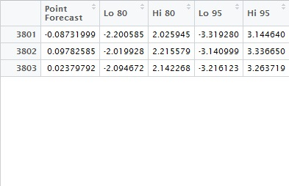
Image of arma.forecast1

Slide 23
Step II: Steps followed to Forecast future stock value using ARMA model
Formula to predict the Stock Closing Value from the Point Forecast:
Point-Forecast for Next day
= 100 * log(Closing Value of Next Day/Closing Value for Current Day)
Closing Value Prediction
= 10^(Point-Forecast/100) * Closing Value for Current Day

Slide 24
RESULT
The predictions of Closing Stock Value for the following dates found from the formula are:
14th May 2013 – 5968.44
15th May 2013 - 5981.90
16th May 2013 – 5985.18

